Slide 1
Theodor Heuss Schule
Secondary School in Bielefeld, Germany
Themes
History
School Building and Rooms
Classes
Subjects
After School Activities
School Teams

Slide 2
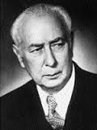
History
Our school is 53 years old
Our school is named after politician Theodor Heuss
He was the 1st President of West Germany from 1949 to 1959 and has founded a party (FDP)

Slide 3
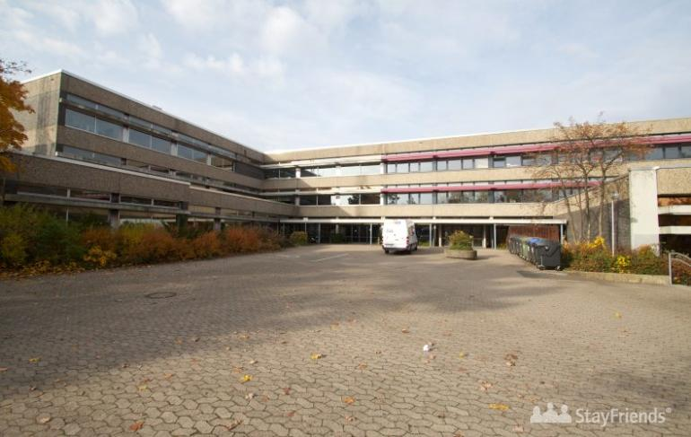
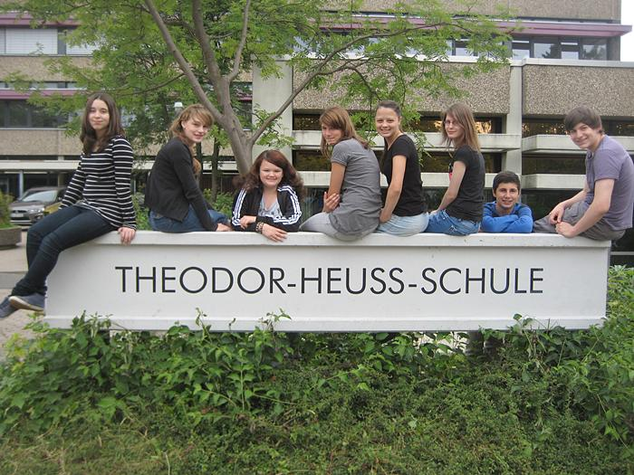
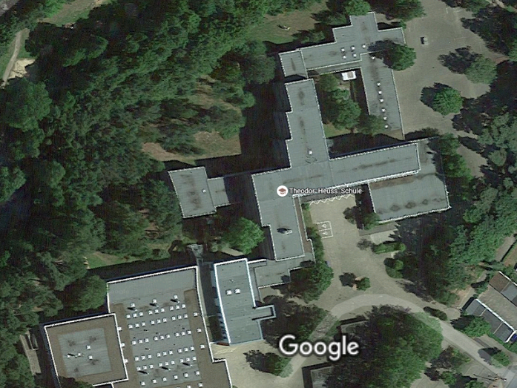
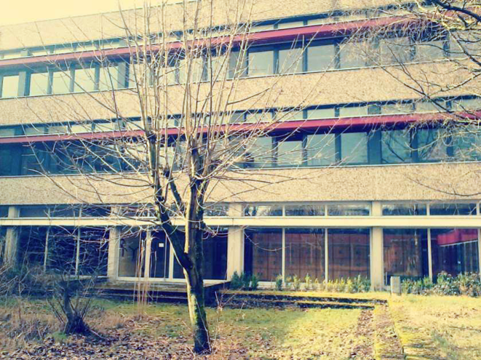
School Building and Rooms
The school building has three floors

Slide 4
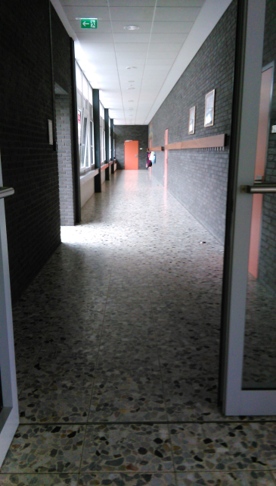
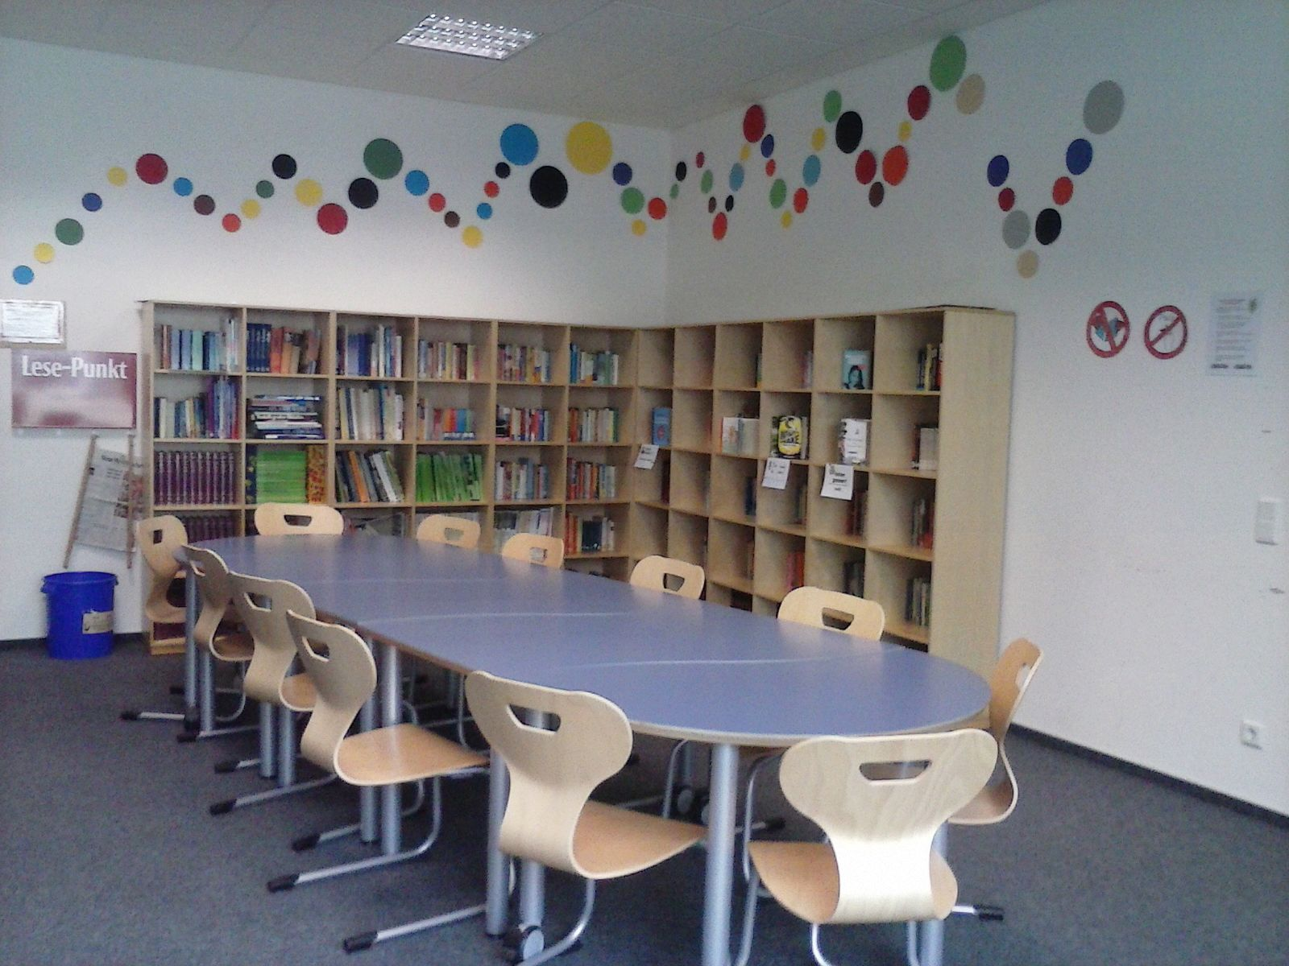
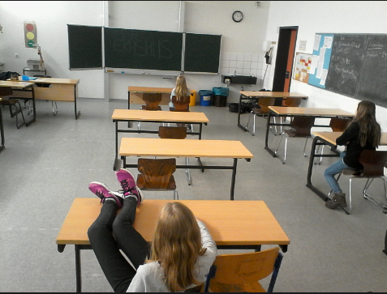
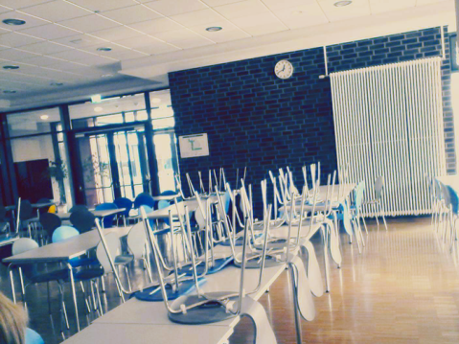
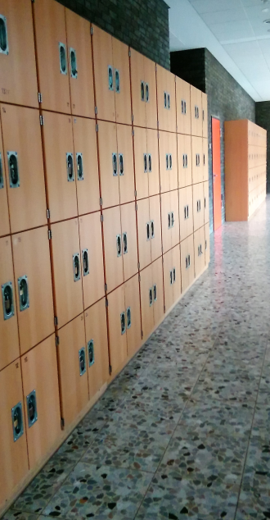
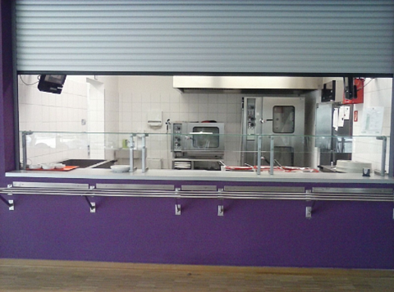
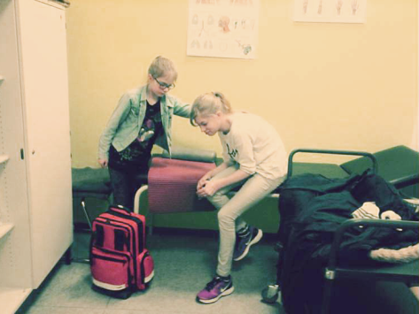
School Building and Rooms
The school has about 30 classrooms, a Library, 2 computer labs, a paramedic room, a canteen, a kiosk …

Slide 5
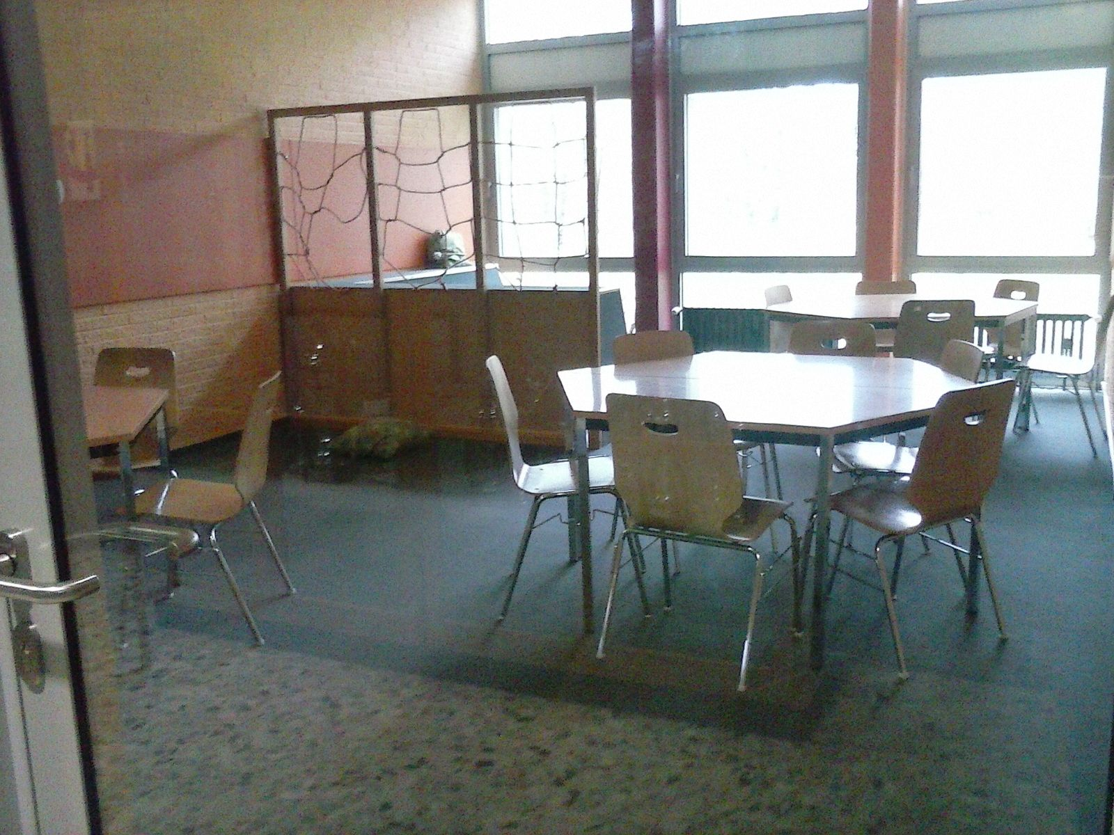
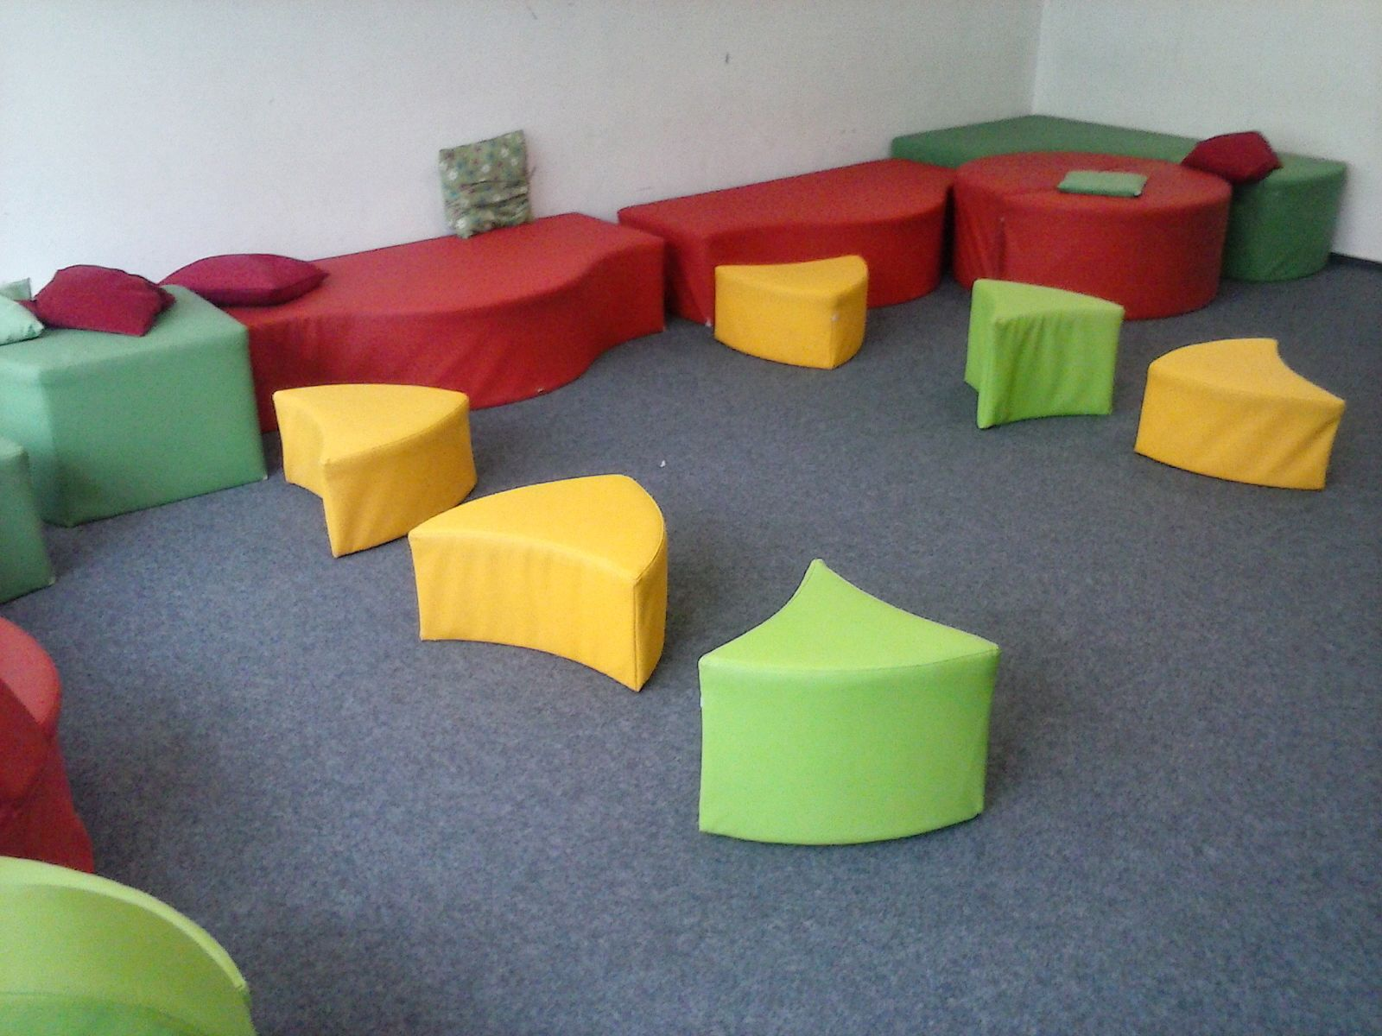
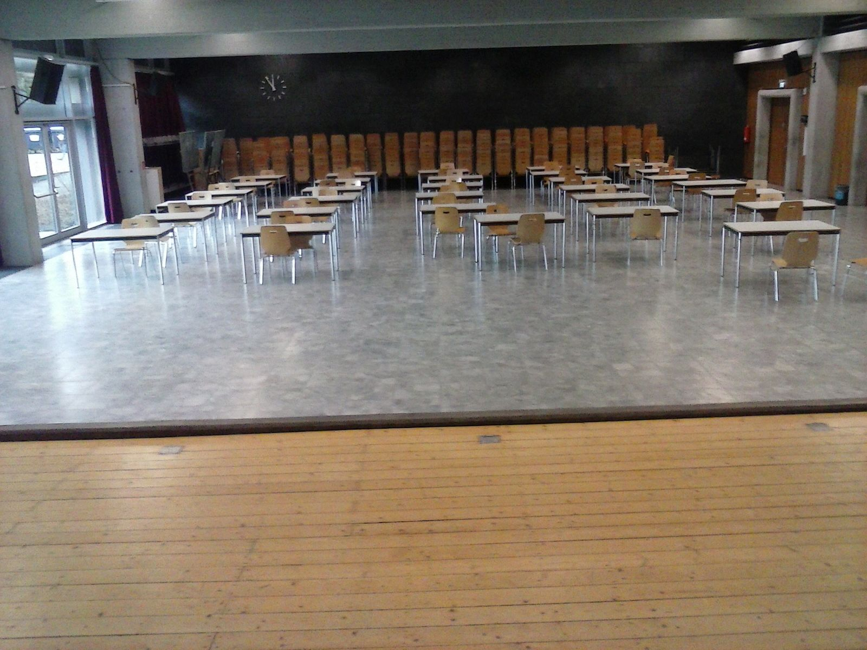
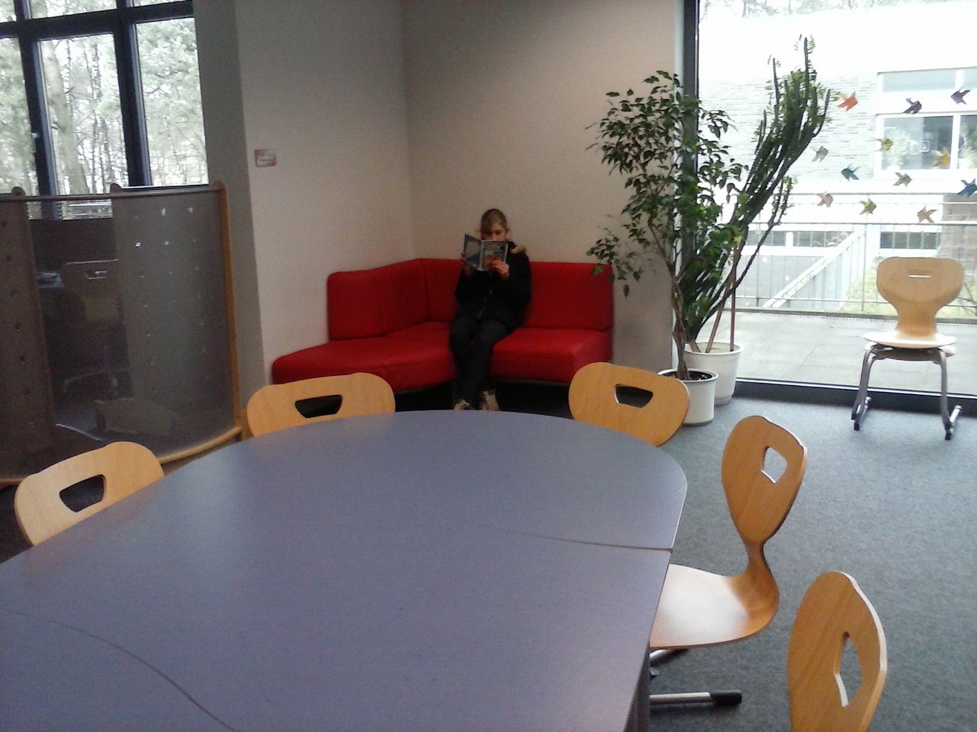
School Building and Rooms
… working rooms, group rooms, a TV room, play and recreation rooms, an assembly hall with theater stage …

Slide 6
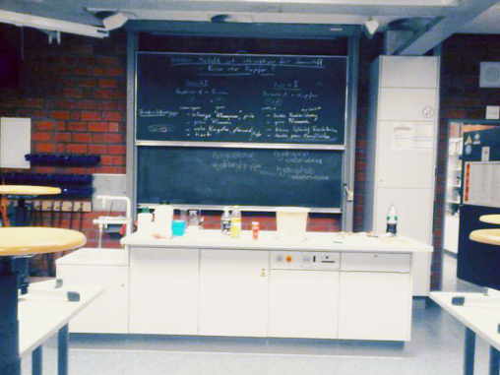
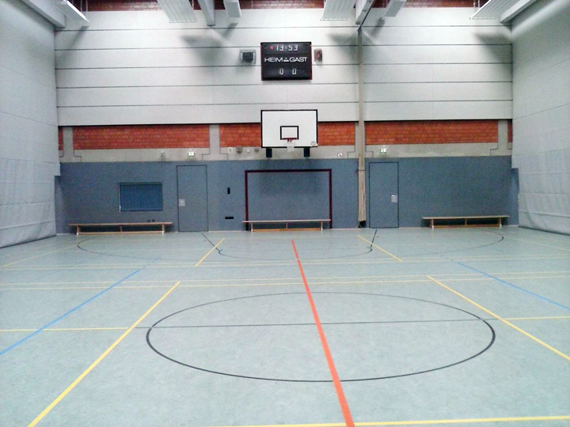
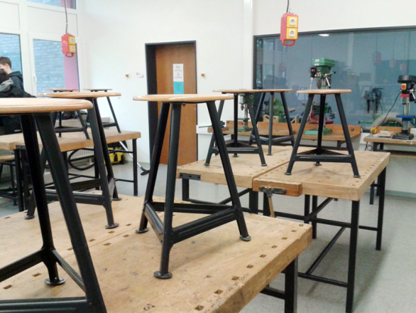
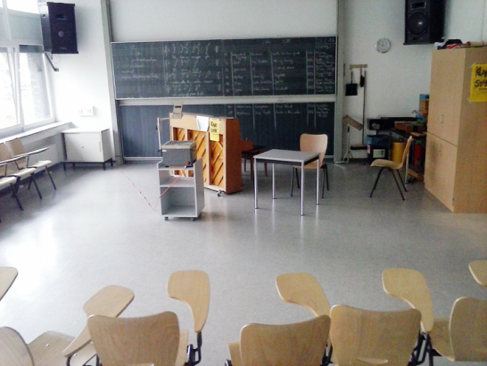
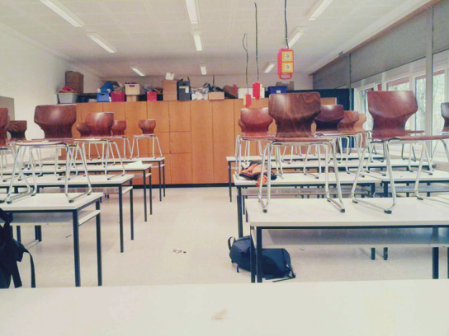
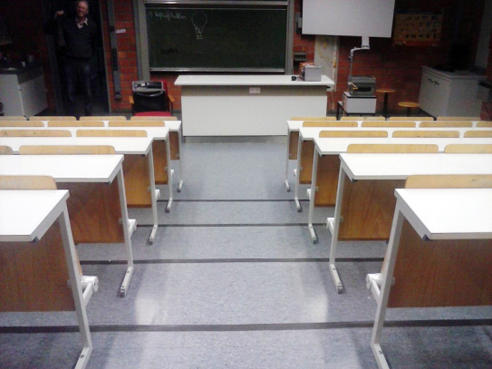
School Building and Rooms
… and labs and rooms for the different school subjects such as natural sciences, technics, arts and crafts and a sports hall.

Slide 7
Classes
0ur classes at school have an average number of 28 pupils, in classes with special children the number of pupils is 25
Every year we have 5 new classes starting in August
The classes at our school are named by the letters of the alphabet
We have 28 classes
We have 2 classes with refugees and immigrants

Slide 8
Subjects
Art
Biology
Chemistry
English
Geography
German
Graphic Design
History
Home Economics
Maths
Musik
Physics
Politics
RE / Religion
Sports / PE
Subject choice in class 7 (this continues until class 10)
• Biology
• Computer Science
• French
• Social Studies
• Technology
Choice of Sports (class 9-10):
• Badminton
• Fitness
• Football
• Gymnastics
• Handball
• Swimming
• Table Tennis

Slide 9
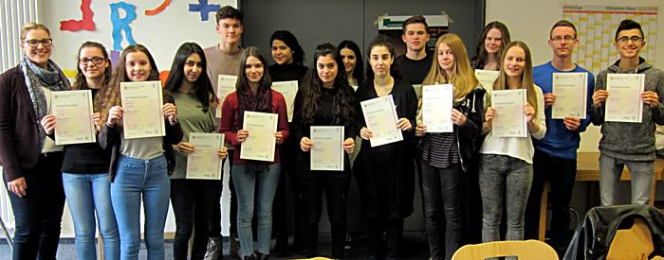
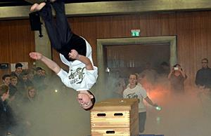
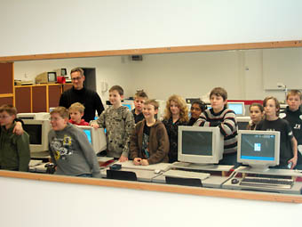
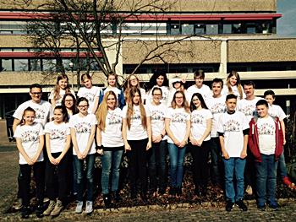
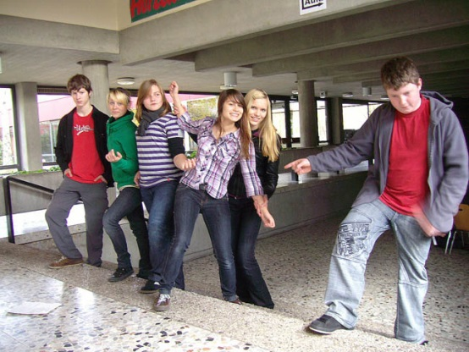
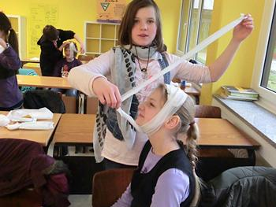
After School Activities
We have many after school activities for example:
Computer
Garden
Drama
School Band
“Flying THS”
Cheerleading
Library
Kiosk
Erasmus +
Paramedics
Cambridge Certificate
Bike Racing
Driving licence class M

Slide 10
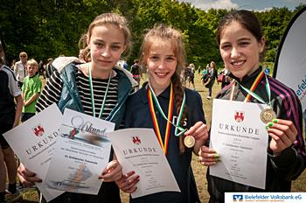
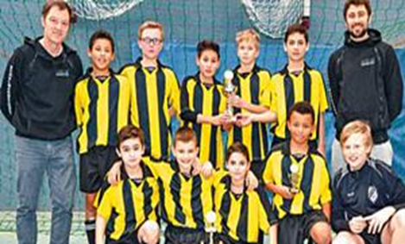
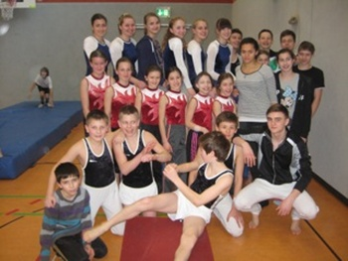
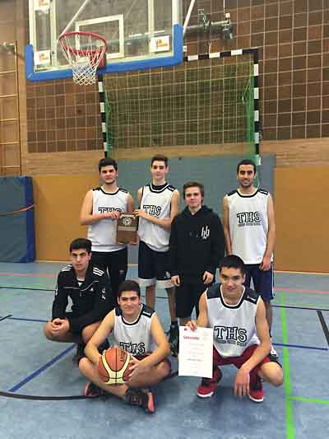
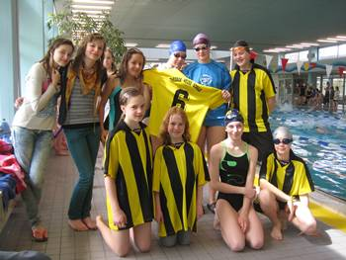
School Teams
We have a few school teams (Boys & Girls teams are separated) at our school for example :
Football Teams
Gymnastics Team
Swimming Team
Volleyball Team
Basketball Team
Table Tennis Team
Sometimes our teams have
won a match or a tournament

