Slide 1
Offers of Learning Support and Educational Help in Bielefeld
Notes:
Hello my name is Sarah
and my name Niklas
and we are going to give you a short survey about
what our city offers to students in the field of learning support and educational help.

Slide 2
What do I want to do after my school days?
Will I find work?
What is my next step in education?
What are my strengths and weaknesses?
What is the right job for me?
Offers of Learning Support and Educational Help in Bielefeld
Notes:
During your time as a student always the same questions concerning your future are coming up
for example
What do I want to do after my school days?
Will I find work?
What is my next step in education?
What are my strengths and weaknesses?
or What is the right job for me?

Slide 3
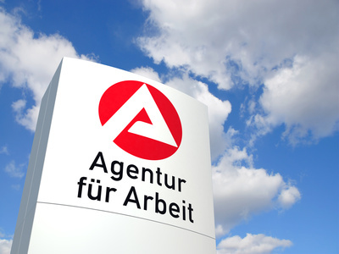
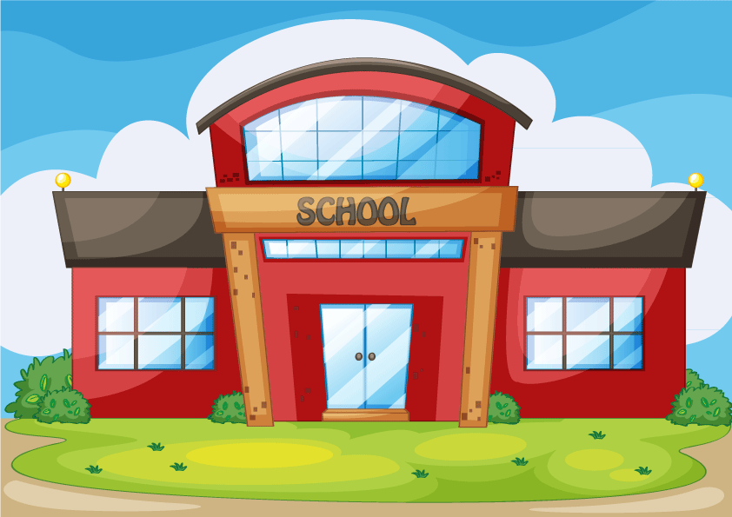
Civic institutions
Employment agency (governmental)
Bielefeld
Various associations and foundations e.g.
Offers of Learning Support and Educational Help in Bielefeld
Notes:
To answer these questions of young people we are getting help from our employment agency
which is a governmental institution,
civic institutions
and many different associations and foundations.

Slide 4
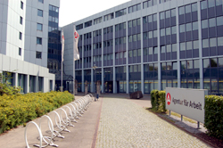
grade 6
grade 8
grade 9
3-week traineeship in companies the students chose by themselves
presentation of the experiences the students made during their traineeships to younger students in an exhibition
job application training
visit of the „Berufsinformationsbörse“
visit of the BIZ
advice about strengths and weaknesses and
recommendations for suitable jobs
grade 10
individual advice by the employment agency
introduction of the secondary schools
Offers of Learning Support and Educational Help in Bielefeld
Notes:
In our school everthing starts in grade 6 with the Girl‘s and Boy‘s Day.
During this day boys and girls are encouraged to check out jobs which are supposed to be gender-specific.
For example girls can work as mechanics and boys as nursery teachers.
In grade 8 all students will visit the Job Information Center, called BIZ,
to get advice about their strengths and weaknesses
and to get first recommendations for suitable jobs and further education.
In grade 9 the students are realizing a 3-week traineeship in a company they chose.
Furthermore they have to tell about the experiences they made to younger students.
They have a job application training and visit the Berufinformationsbörse,
which is a job fair where many different companies and professions are introducing their business.
In grade 10 staff members of the employment agency are visiting the school giving advice to every single student
and the secondary schools are informing the students about their emphases.

Slide 5
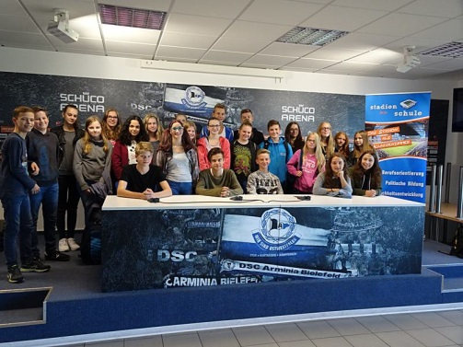
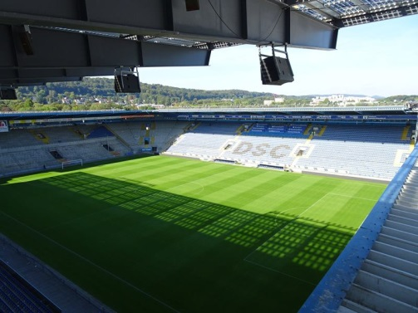
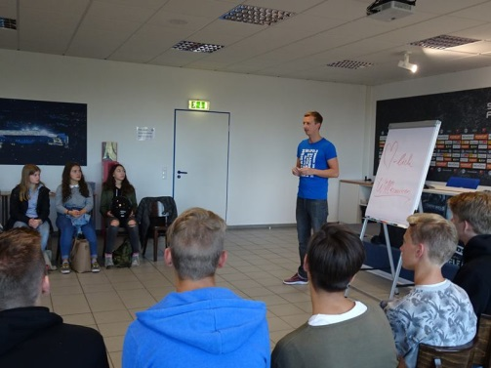
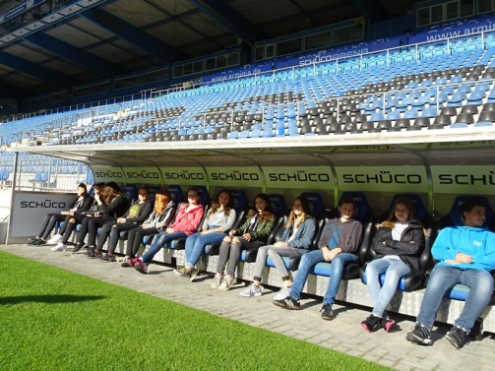
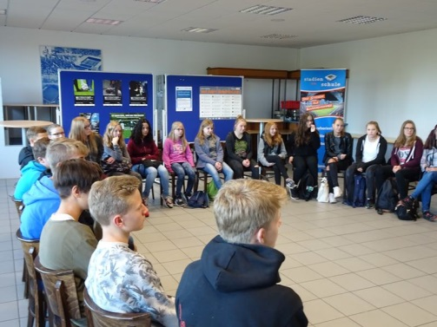
Offers of Learning Support and Educational Help in Bielefeld
Notes:
To give you an example for the educational work of the various associations and foundations
we visited our local football team „Arminia Bielefeld“
to inform us about their project „Stadionschule“
they are realizing together with the Robert Bosch Stiftung and the REGE, a civic education company.
There, students are invited to visit the stadion
and can do workshops for political education, personality development or career guidance classes.
They gave us an overview about their work teaching short examples from the three subjects.
We had lots of fun and a sightseeing tour to the stadion.
Thank you for listening and this is the end of our presentation.

Slide 6
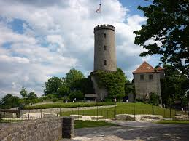
Free-Time activities for Young People in Bielefeld

Slide 7
Sports
There are many types of sports you can do in this city, and there is great webpage from the council for all things you may need to find out.
Sports available are:
Football, tennis, golf, climbing, running, walking, squash, fitness, swimming
and many more …
Free-Time activities for Young People in Bielefeld

Slide 8
Here you can find information on sports in Bielefeld
Free-Time activities for Young People in Bielefeld

Slide 9
Shopping
Bielefeld has a great selection of shops for all kind of budgets. Lately we have had big chains opening shops in Bielefeld, such as TKMaxx and there will be Primark and others soon.
There is a vast shopping and food center being built just now, due to open in autumn 2017 called „The Loom“
Bielefeld has an old and a new part of the city. Bothe parts have different kinds of shops, the old part has more expensive shops like Joop and Benetton, the new part has shops like Pimkie and C&A.
Free-Time activities for Young People in Bielefeld

Slide 10
Help on shopping on the Bielefeld webpage
Free-Time activities for Young People in Bielefeld

Slide 11
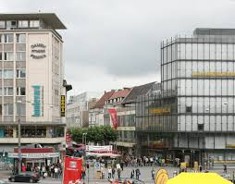
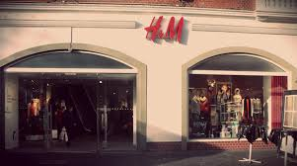
Free-Time activities for Young People in Bielefeld

Slide 12
Eating Out
Free-Time activities for Young People in Bielefeld

Slide 13
Enjoy a Meal in Bielefeld There are all kinds of restaurants in Bielefeld, from fast food places to exotic kind of food right up to the Michelin Star place.
Free-Time activities for Young People in Bielefeld

Slide 14
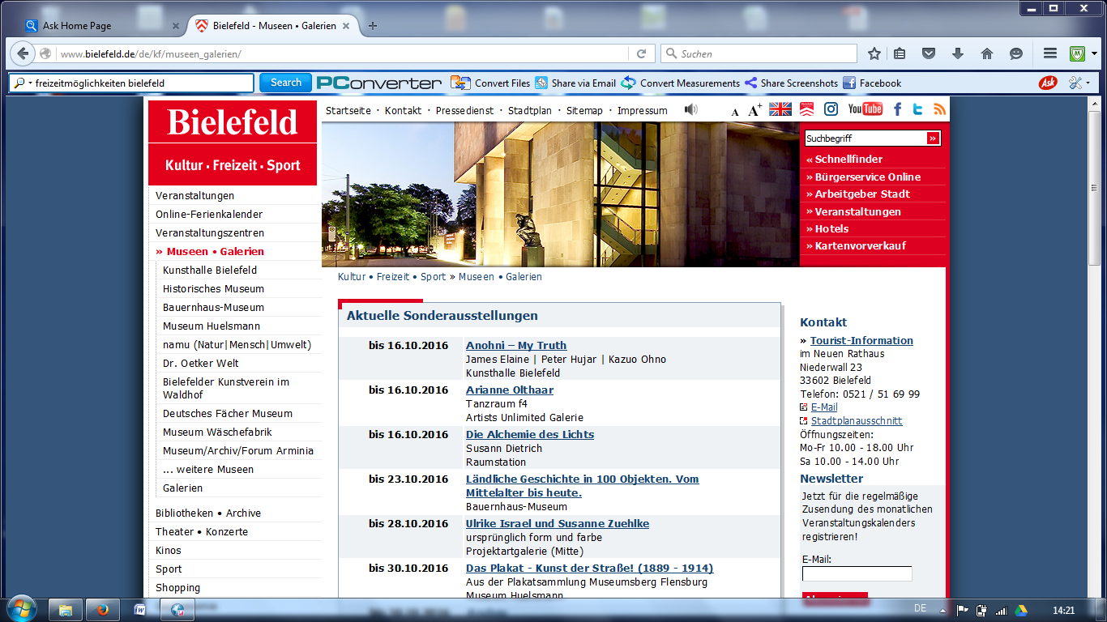
Museums, Galleries, Theatre
We have many museums, some of them have workshops for young people and school classes
Different types of mueums like the Historical Museum, the Washing Museum and the farm museum appeal to a variety of people
Young people and persons on a low income can get a pass to get in for free
Free-Time activities for Young People in Bielefeld

Slide 15
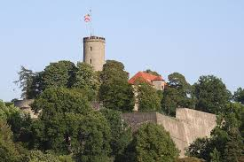
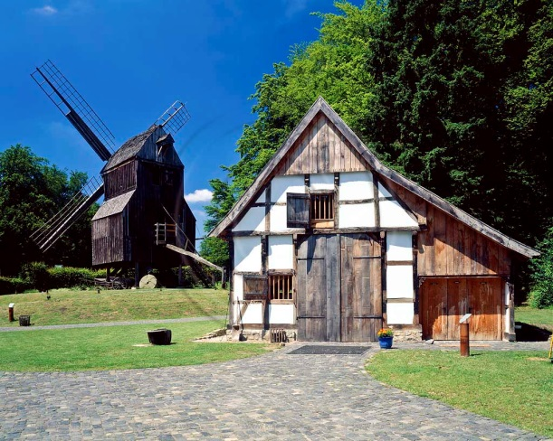
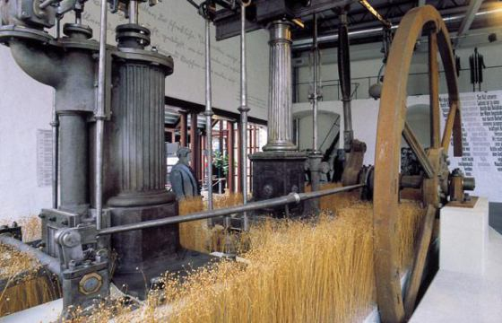
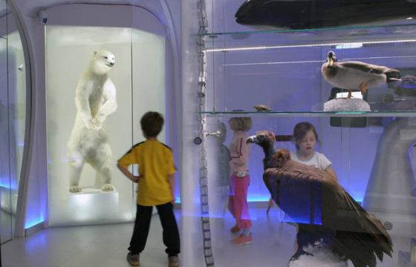
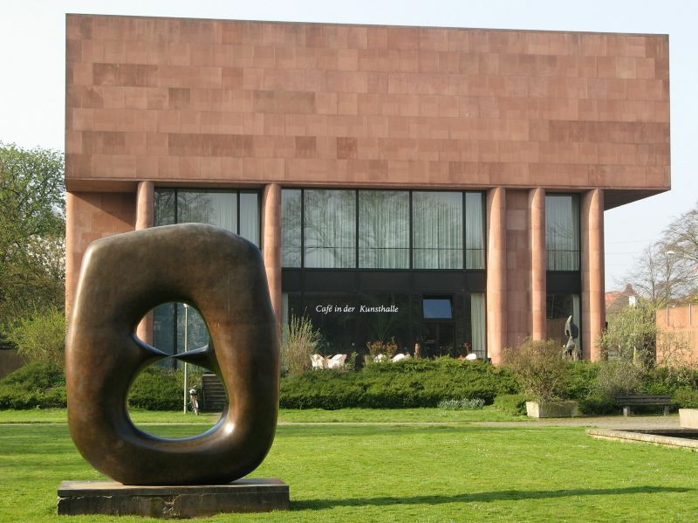
Museums of Bielefeld
Free-Time activities for Young People in Bielefeld

Slide 16
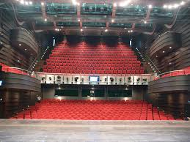
Theatre of Bielefeld This Season:The Merchant of Venice, Don Carlo, Opera meets Rap and Miss Havisham`s wedding
Free-Time activities for Young People in Bielefeld

Slide 17
Luna Sennestadt A local Youth Center next to our school
Free-Time activities for Young People in Bielefeld

Slide 18
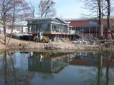
Luna
Opened in 1968 and completely re-built in 2012
Club rooms, Play rooms, Kitchen, Assembly with stage, mucis band practice room,sound studio with recording equipment, painitng rooms, great outside
3 groups
Children aged 6-12
Young teens aged 11 -14
Youths 14+
Free-Time activities for Young People in Bielefeld

Slide 19
Sportfreunde Sennestadt There are many Sports clubs right near the school and the local one is this:
Free-Time activities for Young People in Bielefeld

Slide 20
Sports and free-time activites at THS Bielefeld
At our school, we have sports clubs like trampoline, gymnastics and cycling, these sports are also taught to a hogh national level, as we are a specialised sports school
We also have gardening clubs, theatre clubs and debating groups.
A school year book group is very popular and also the study tuition group, where older students teach younger students in Maths, German and English
Free-Time activities for Young People in Bielefeld

Slide 21
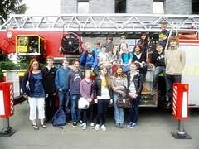
Free-Time activities at THS for example: gymnastics, football, first aid
Free-Time activities for Young People in Bielefeld

Slide 22
the end
Offers of Learning Support and Educational Help in Bielefeld

